Slide 1
M-Loy9
Colin Spurway and Ros Marie
BBC Media Action

Slide 2
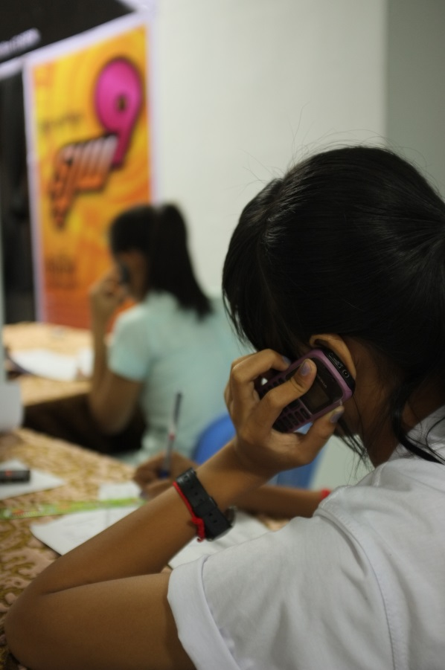
M-Loy9
- 30 Respondents
16 episodes, parallel with the TV weekly show
4 Segments:
Dial 1: Short Audio Drama
Dial 2: Fact of the Week
Dial 3: Susu Lala (Q and A)
Dial 4: Voice message
Total: Six to seven minutes

Slide 3
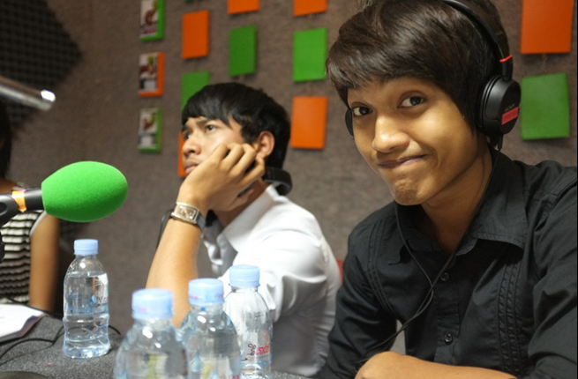
M-Loy9
Findings:
M-loy9 was seen as:
Encouraging cooperation,
Improving confidence,
Providing important information,
For some participants it also reduced feelings of stress or isolation.
“Last month there was a meeting in my village with over 20 participants including villagers, NGO representatives, village chief and youth. I expressed my opinion about the [problem of] clean water and diarrhoea in my village, and then I dialled the m-Loy9 short code 9000 and we listened altogether about this problem.”
Farmer, Female, 18, Kompong Chhnang

Slide 4
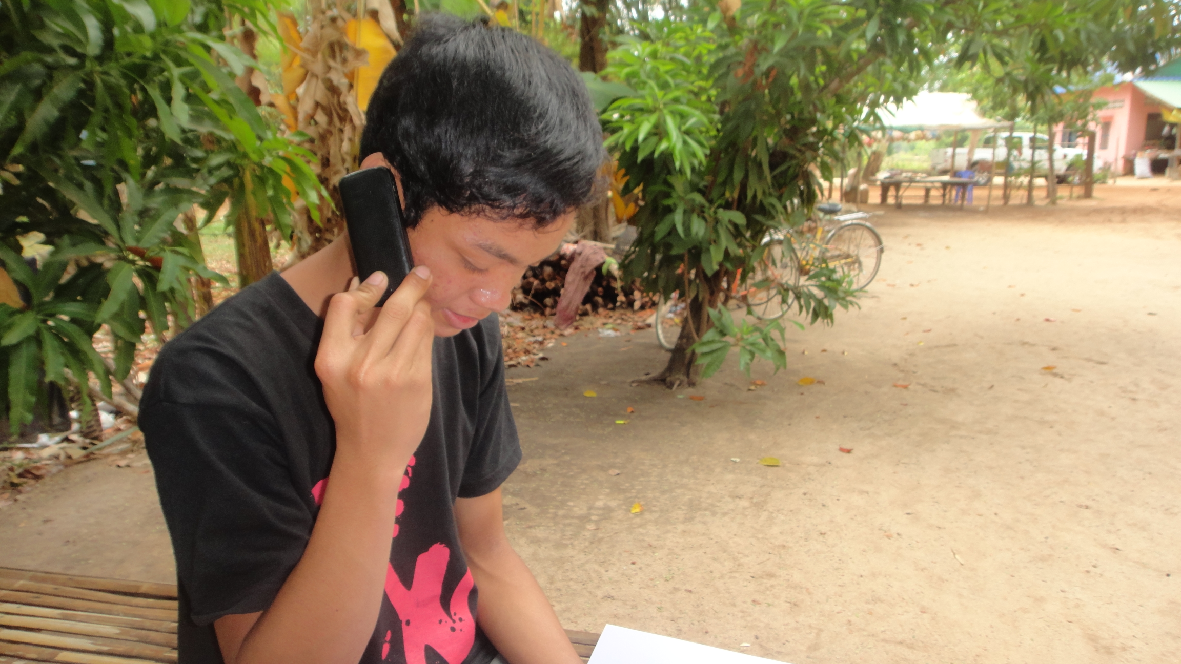
Verboice
Easy to learn how to use
Users are familiar
Short Code “9000”

Slide 5
Contacts:
Colin Spurway
colin.spurway@kh.bbcmediaaction.org
Ros Marie
ros.marie@kh.bbcmediaaction.org

